Slide 1
AMAZON SALES DATA ANALYSYS

Slide 2
INTRODUCTION
The following report presents a comprehensive analysis of Amazon sales spanning the years 2010 to 2017. Amazon, the global e-commerce giant, has witnessed substantial growth and evolution over this period, reflecting both its internal strategies and the broader market dynamics. This analysis aims to provide insights into various aspects of Amazon's sales performance, including revenue trends, product categories, geographical distribution, and sales channels. By examining sales data from multiple perspectives, this report offers valuable insights into Amazon's market position, competitive strategies, and potential growth opportunities.

Slide 3
ANALYSIS BASED ON
ITEMS SET
BABY FOOD
BEVERAGES
CEREAL
CLOTHES
COSMETICS
FRUITS
HOUSEOLD
MEAT
OFFICE SUPPLIERS
PERSONAL CARE
SNACKS
VEGETABLE
TIME PERIOD
2010
2011
2012
2013
2014
2014
2016
2017
REGION
EUORPE
AUSTRALIA AND OCEANIA
ASIA
CENTRAL AMARICA AND CARABIAN
MIDDLE EAST
SUB-SAHARAN AFRICA
NORTH AMERICA

Slide 4
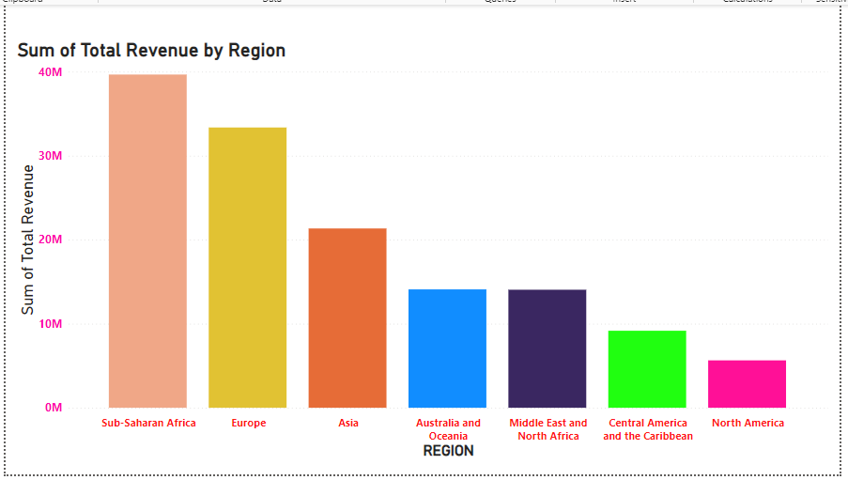
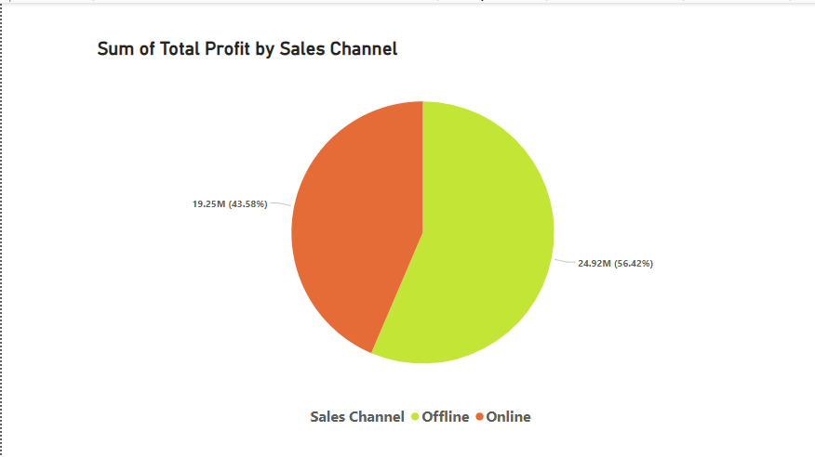
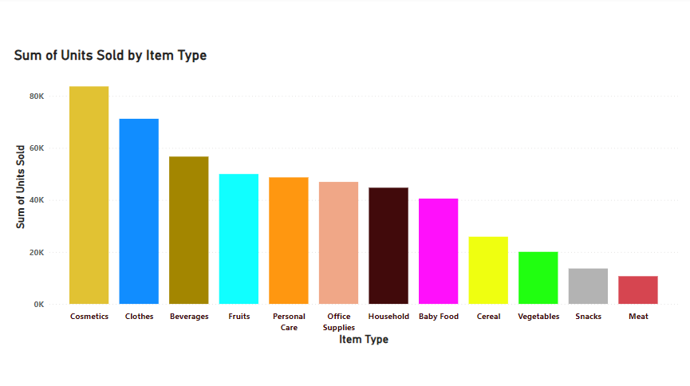
MY FINDINGS

Slide 5
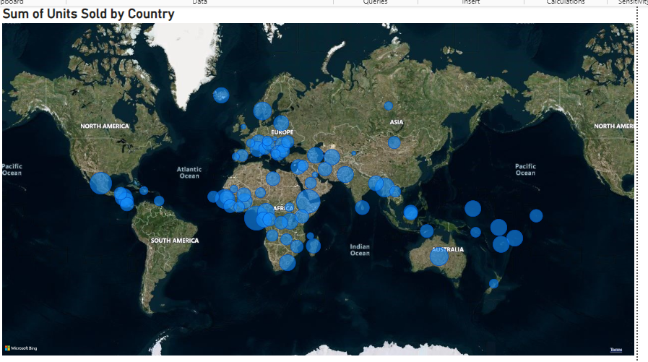
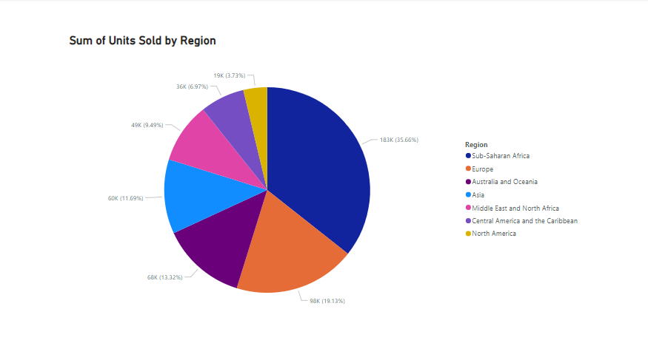
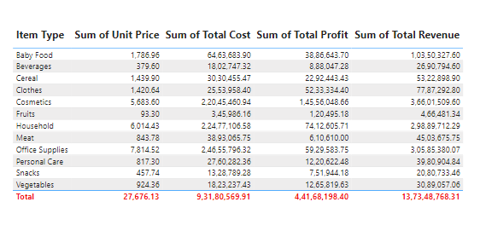

Slide 6
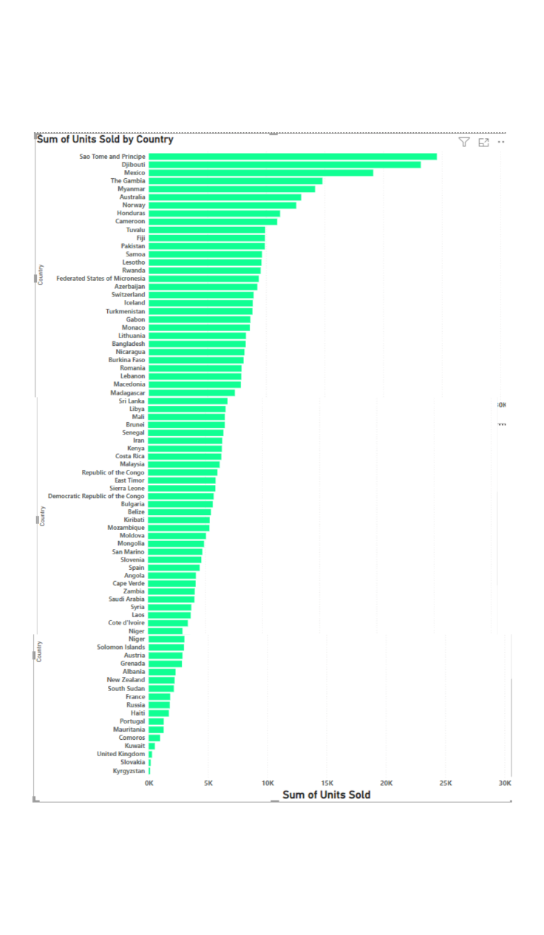
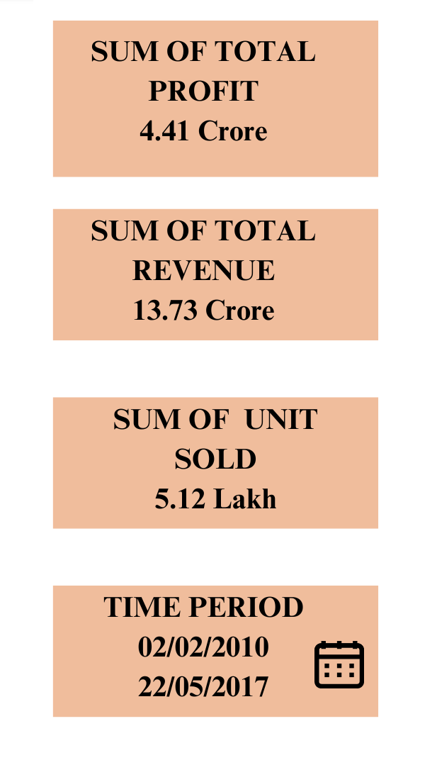
In the given image based on analysis we can see Sao Tome
And Principe ranked top at highest number of unit sold whereas Kyrgystan stands at last position.

Slide 7
RESULT
SUB-SAHARAN AFRICA occupied the first place in total revenue generated among all
Other regions.
Offline sales channel has gain more profit than the online sales channels.
Company gain 47.4% of the profit.
Cosmetics and Clothing product are highest selling product between 2010-2017. While
Meat items were least selling.
Sub-Saharan Region had highest sum of units sold among all other regions.
The year with the maximum revenue based on the provided data is: 2017.

Slide 8
THANK YOU

